Slide 1
AI Ethiticis and AI Bias

Slide 2
Background
Why Boston Housing Prediction Dataset take the proportion of African as one feature dimenstion?
Why Kaggle Facial Landmark Dataset stores the data in csv rather than image?

Slide 3
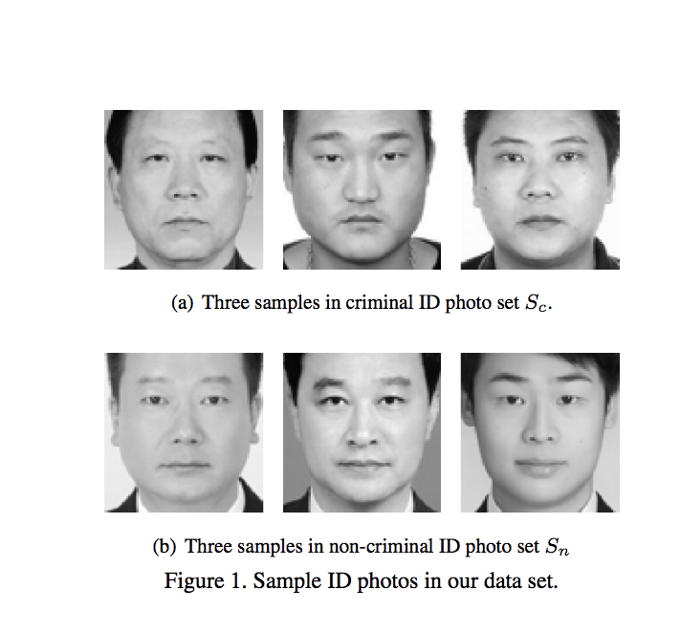
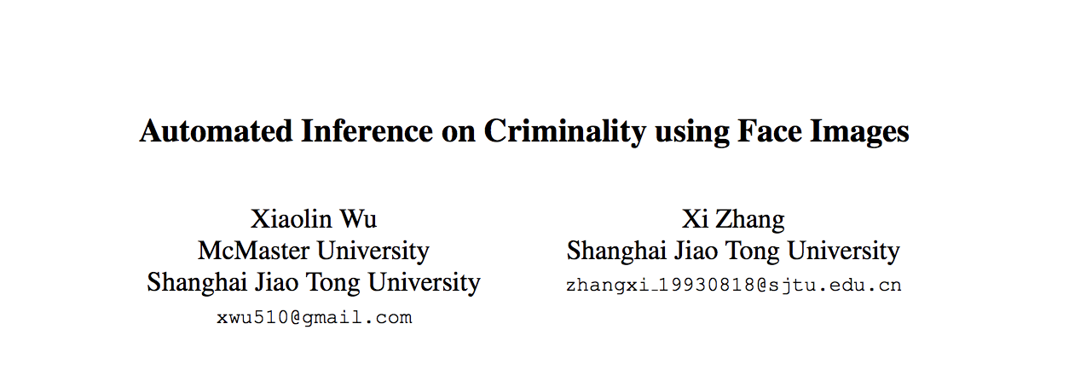
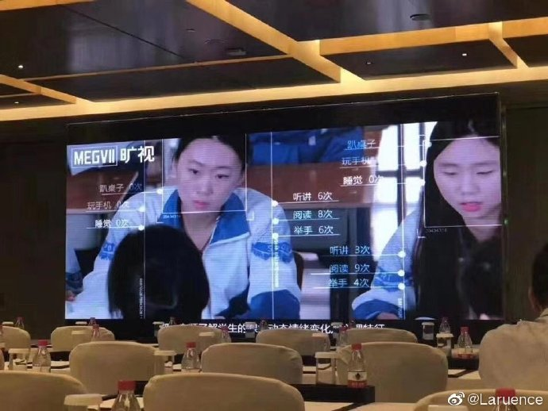
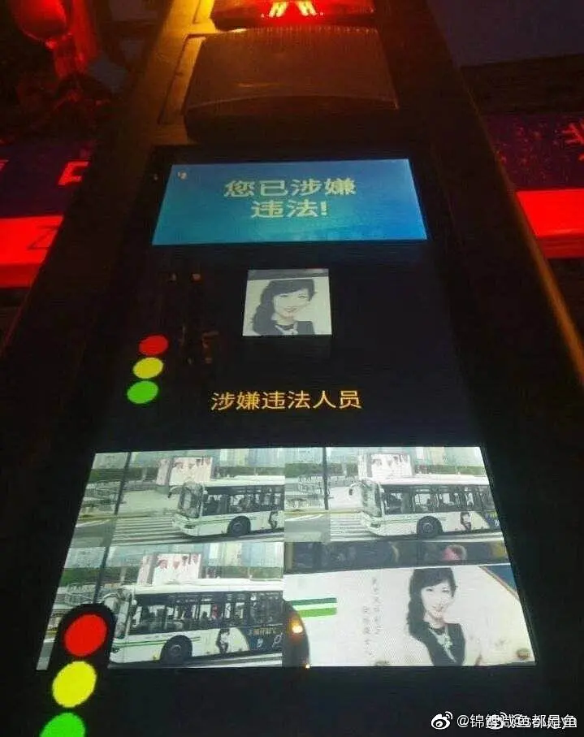
Some controversial AI usage: CV

Slide 4
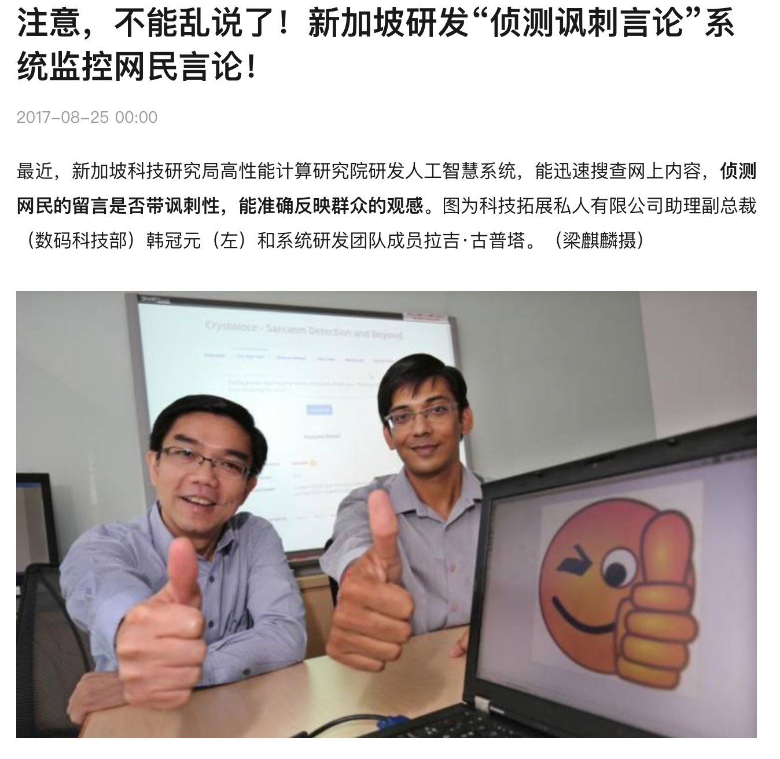

Some controversial AI usage: NLP
うつ病で、飛び降りたいです

Slide 5
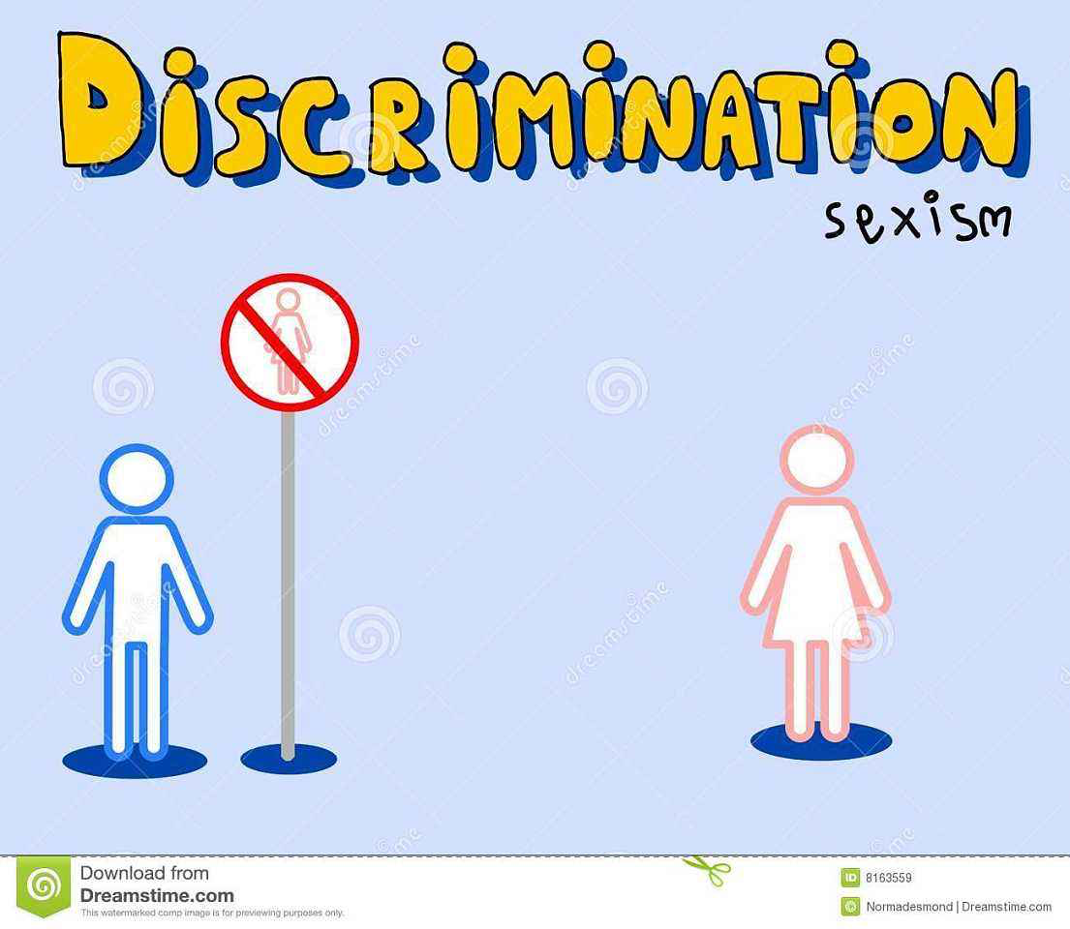
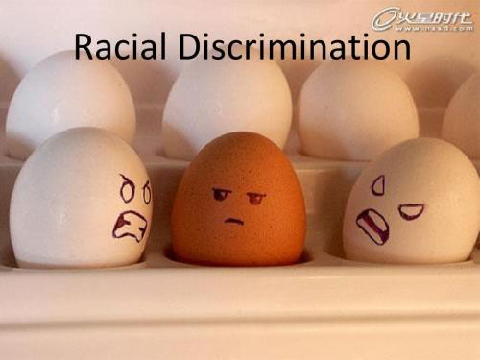
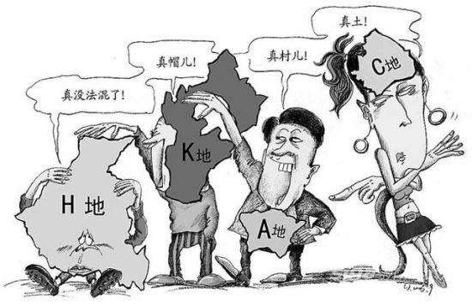

Sensitive features and causal influences
Gender
Race (Boston Housing 's feature)
Education
Class
Some intimacy data for recommendation system in web

Slide 6
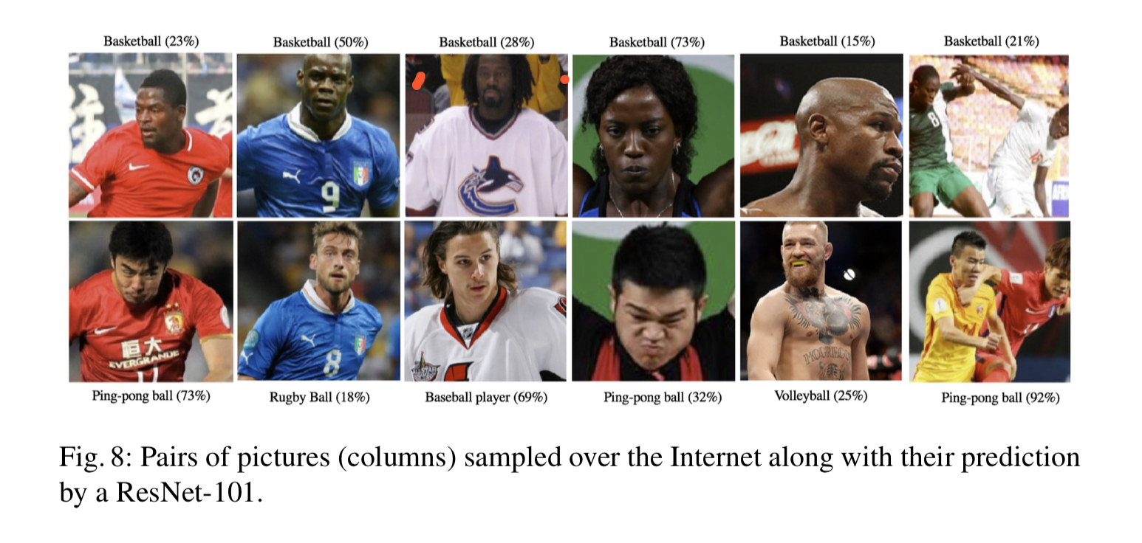
Bias in data reprensentation
Current supevervised learning's shortcomings:
Source: Stock et al., 2017《ConvNets and ImageNet Beyond Accuracy: Understanding Mistakes and Uncovering Biases》

Slide 7

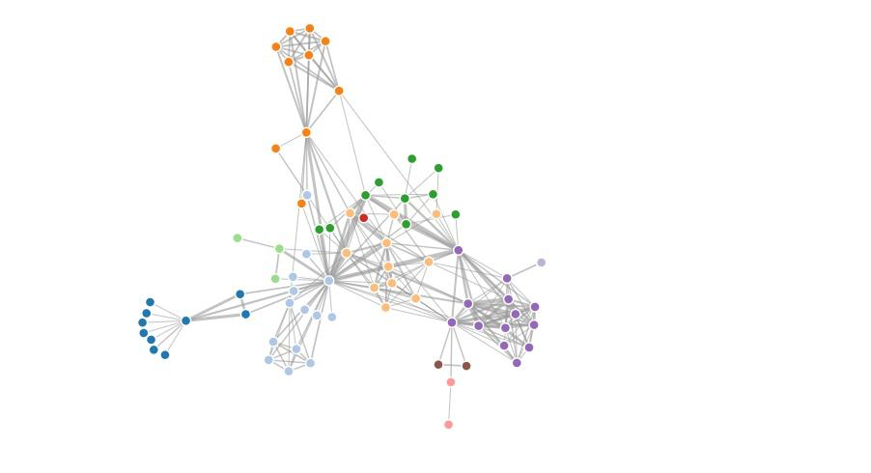
Priori knowledge from human society
End-to-end diaglog system with some "bad" corpus
Knowledge graph from encyclopedia with some different view

Slide 8
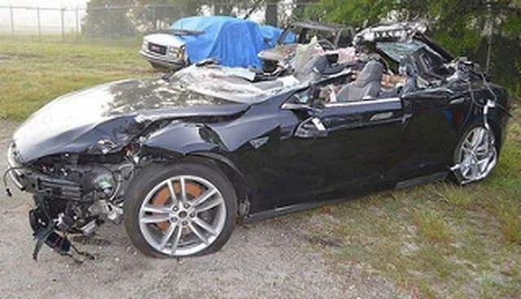
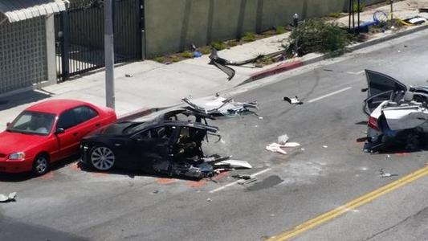
Uncertainty in autonomous driving
Traditional traffic accident can be responsible in previous human society.
What is the subject for the accident in autonomous driving: Vehicle owner or Vehicle manufacturer

Slide 9
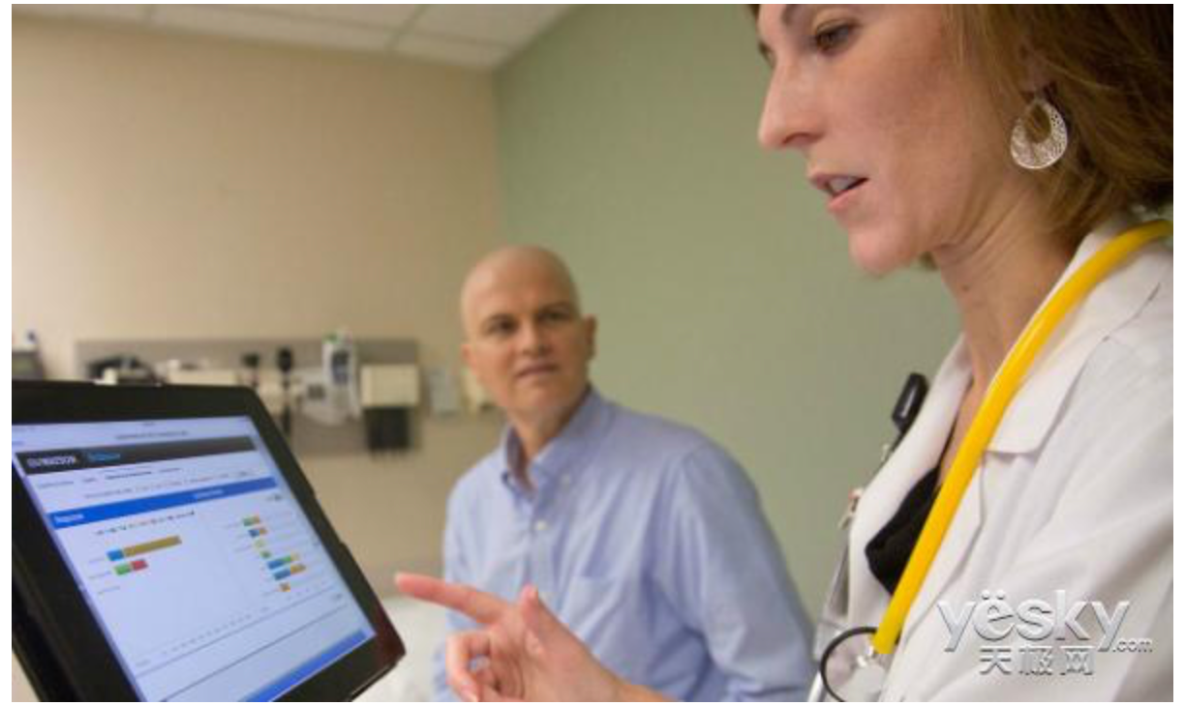
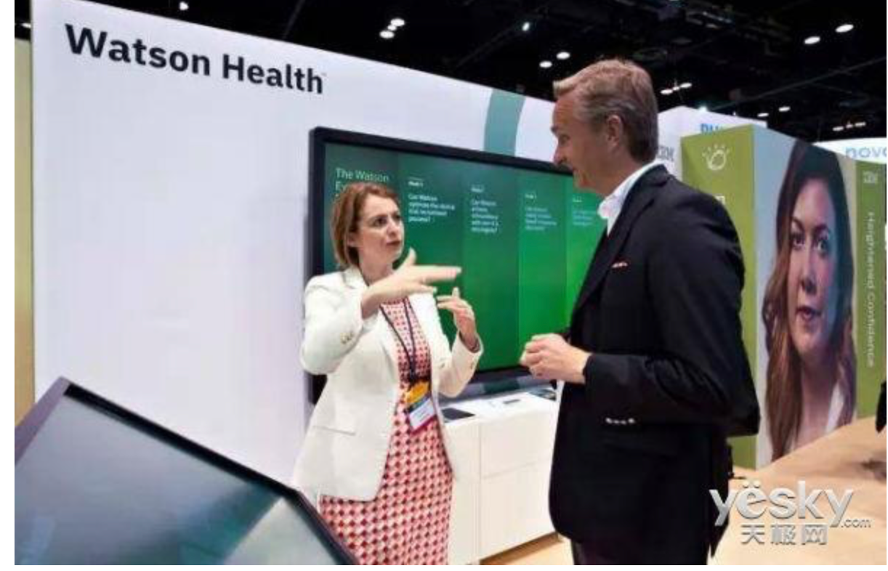
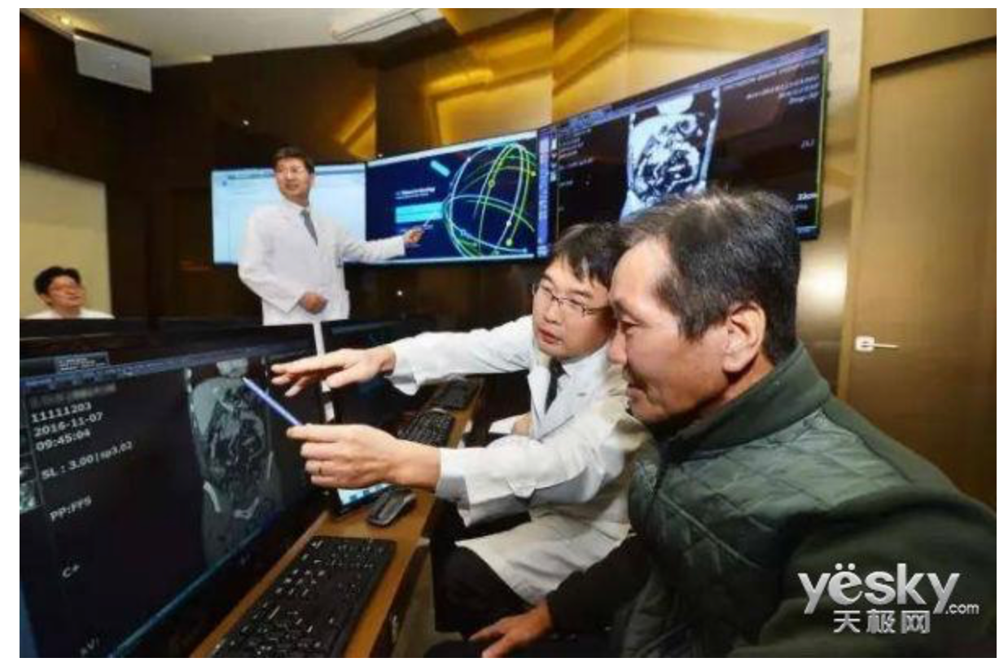
Failure in IBM Waston
Many conflicts between doctor and patients.
Can we tolerate the cost of the exploration of AI doctor.
It is difficult for AI to have the strong cognition ability as human doctor

Slide 10
Solutions
Collect "balanced" data
Ensemble model (bagging & boosting) for fairness AI model
GAN training to minimial the prejudice
Explaniable data with explainable model for posterior evaluation

Slide 11
Tips
No conclusive mature method to tackle the bias
Social gap on the usage of AI
"fairness cannot be reduced to a simple self-contained math- ematical definition”, “fairness is dynamic and social and not a statistical issue”, “fair is not fair everywhere”
Be clear on the assumption of AI system design and its ability and unattainability
Legal issue should be made on open discussion for the progress of our society and technology
Current is weak AI, not strong AI. Stop exaggerated propaganda

